Slide 1
Eliminating Toil
SRE Principles

Slide 2
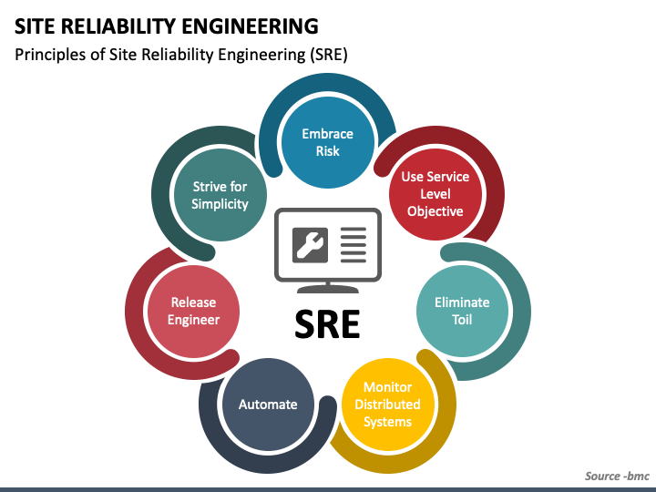
Principles

Slide 3
Toil
Toil is the kind of work tied to running a production service that tends to be manual, repetitive, automatable, tactical, devoid of enduring value, and that scales linearly as a service grows.
Notes:
Manual: This includes work such as manually running a script that automates some task.
Running a script may be quicker than manually executing each step in the script,
but the hands-on time a human spends running that script (not the elapsed time) is still toil time.
Repetitive : If you’re performing a task for the first time ever, or even the second time,
this work is not toil. Toil is work you do over and over. If you’re solving a novel problem
or inventing a new solution, this work is not toil.

Slide 4
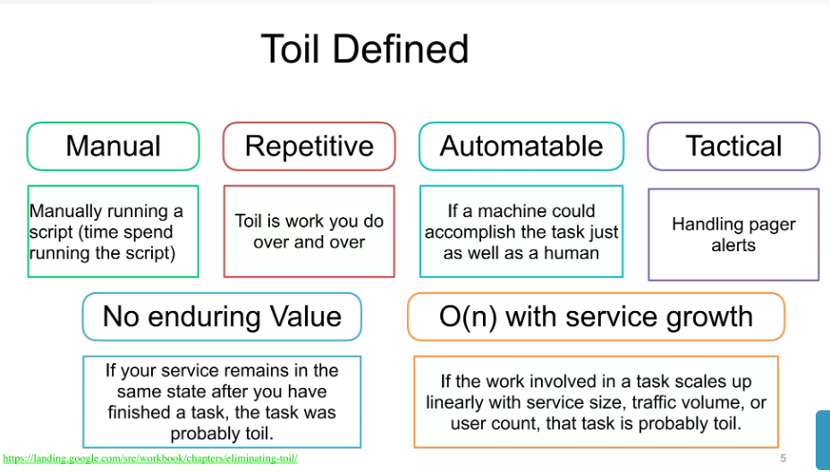

Slide 5
Toil
Manual
This includes work such as manually running a script that automates some task. Running a script may be quicker than manually executing each step in the script, but the hands-on time a human spends running that script (not the elapsed time) is still toil time.
Repetitive
If you’re performing a task for the first time ever, or even the second time, this work is not toil. Toil is work you do over and over. If you’re solving a novel problem or inventing a new solution, this work is not toil.
Automatable
If a machine could accomplish the task just as well as a human, or the need for the task could be designed away, that task is toil. If human judgment is essential for the task, there’s a good chance it’s not toil

Slide 6
Toil
Tactical
Toil is interrupt-driven and reactive, rather than strategy-driven and proactive. Handling pager alerts is toil. We may never be able to eliminate this type of work completely, but we have to continually work toward minimizing it.
No enduring value
If your service remains in the same state after you have finished a task, the task was probably toil. If the task produced a permanent improvement in your service, it probably wasn’t toil, even if some amount of grunt work—such as digging into legacy code and configurations and straightening them out—was involved.
O(n) with service growth
If the work involved in a task scales up linearly with service size, traffic volume, or user count, that task is probably toil. An ideally managed and designed service can grow by at least one order of magnitude with zero additional work, other than some one-time efforts to add resources.

Slide 7
Why Less Toil Is Better
SRE organization has an advertised goal of keeping operational work (i.e., toil) below 50% of each SRE’s time.
At least 50% of each SRE’s time should be spent on engineering project work that will either reduce future toil or add service features.
Feature development typically focuses on improving reliability, performance, or utilization, which often reduces toil as a second-order effect

Slide 8
Toil
The work of reducing toil and scaling up services is the "Engineering" in Site Reliability Engineering.

Slide 9
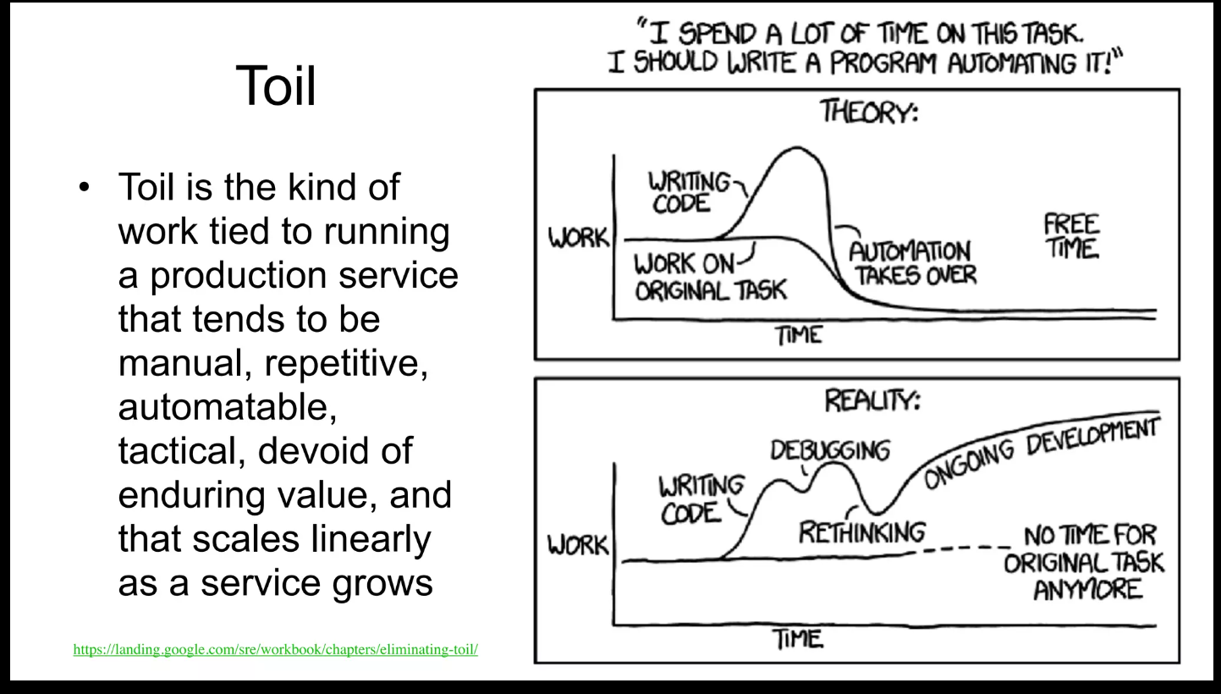

Slide 10
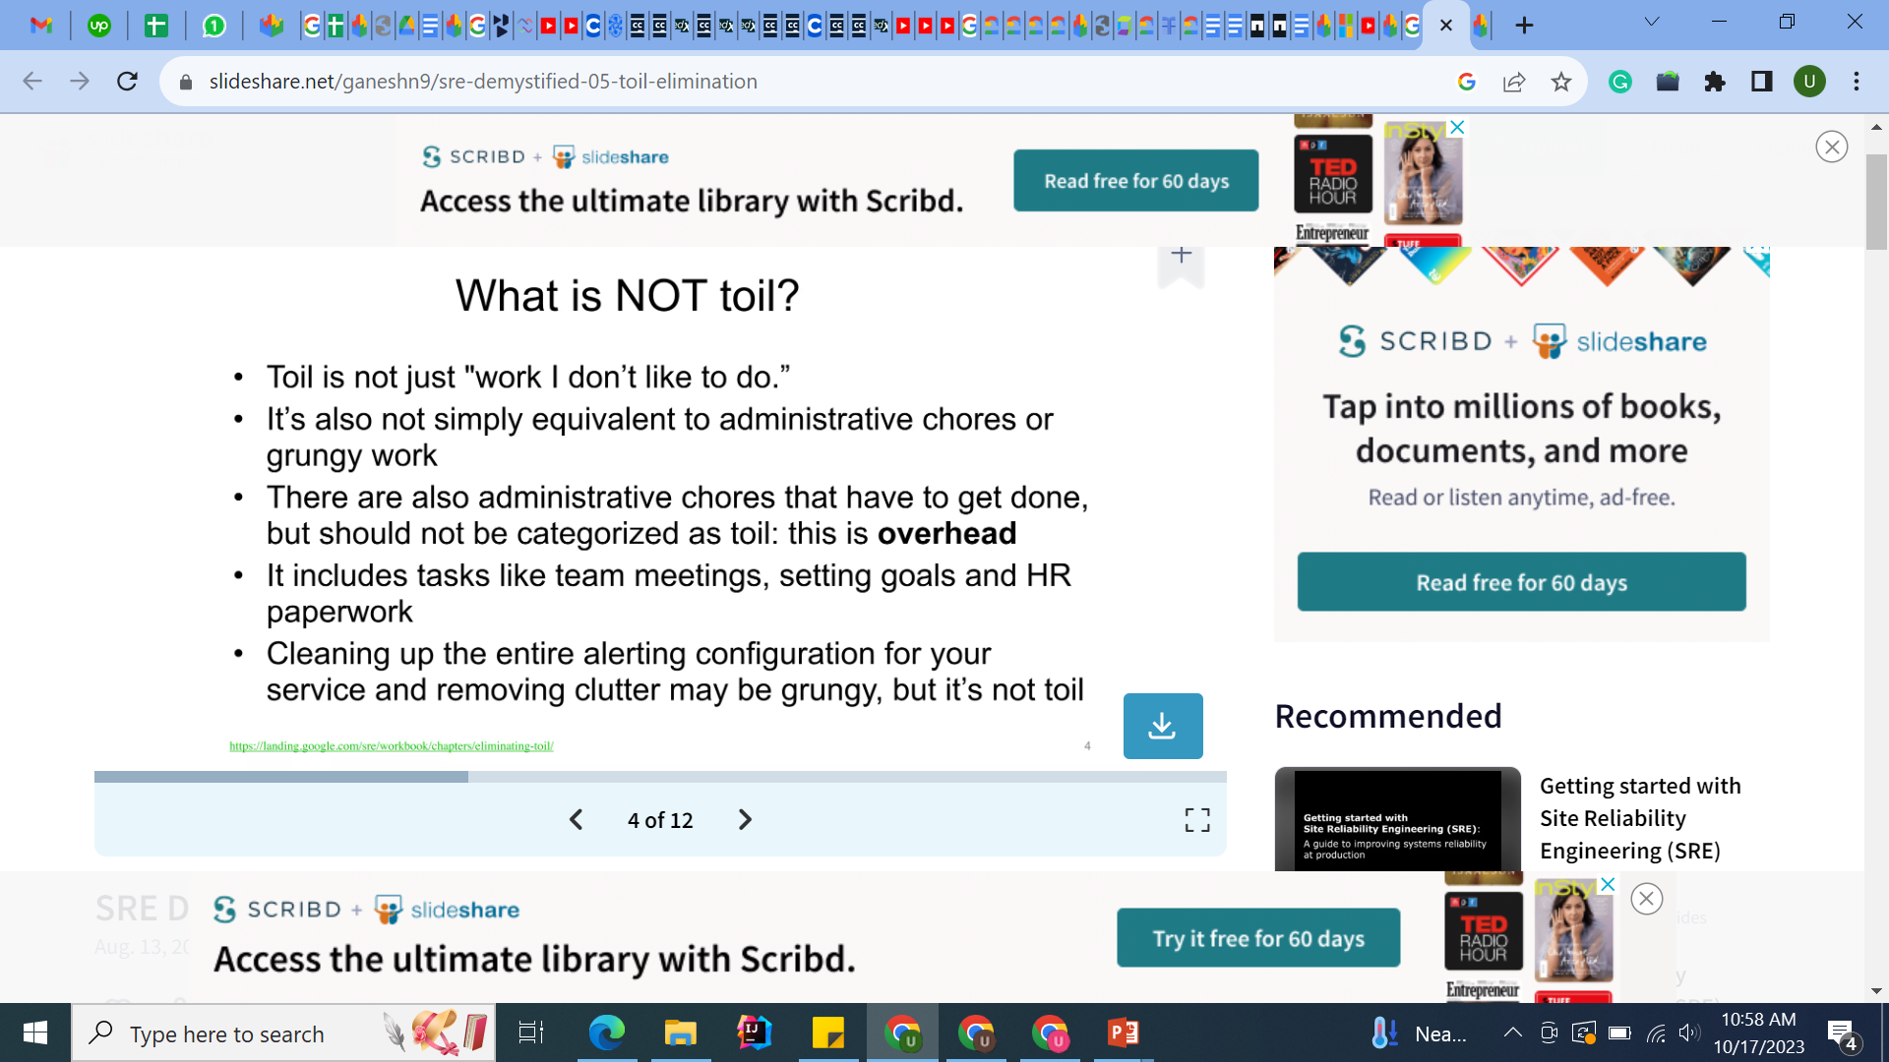
What is NOT Toil

Slide 11
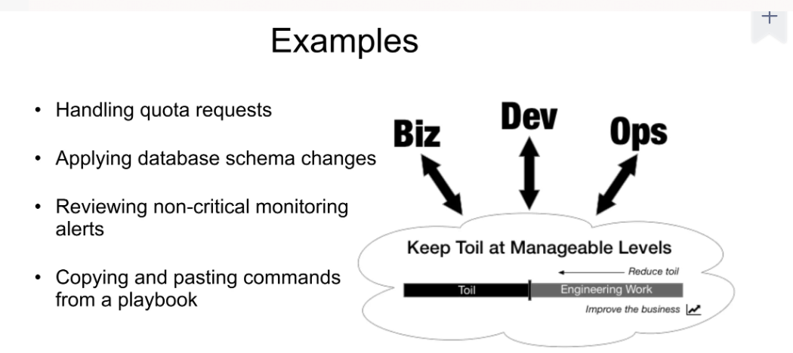

Slide 12
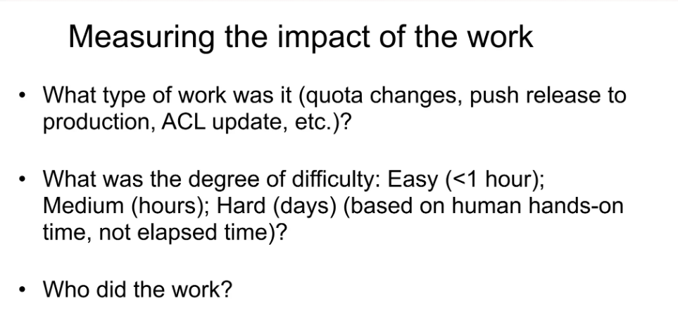

Slide 13
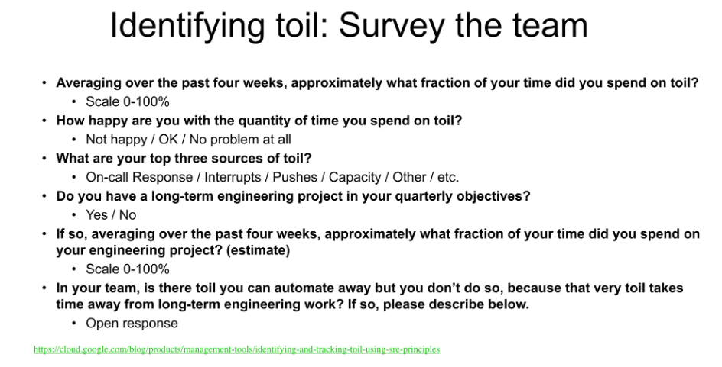

Slide 14
Example
Example: Manual Response to Toil
by John Looney, Production Engineering Manager at Facebook, and always an SRE at heart
It’s not always clear that a certain chunk of work is toil. Sometimes, a “creative” solution—writing a workaround—is not the right call. Ideally, your organization should reward root-cause fixes over fixes that simply mask a problem.
My first assignment after joining Google (April 2005) was to log in to broken machines, investigate why they were broken, then fix them or send them to a hardware technician. This task seemed simple until I realized there were over 20,000 broken machines at any given time!
The first broken machine I investigated had a root filesystem that was completely full with gigabytes of nonsense logs from a Google-patched network driver. I found another thousand broken machines with the same problem. I shared my plan to address the issue with my teammate: I’d write a script to ssh into all broken machines and check if the root filesystem was full. If the filesystem was full, the script would truncate any logs larger than a megabyte in /var/log and restart syslog.
My teammate’s less-than-enthusiastic reaction to my plan gave me pause. He pointed out that it’s better to fix root causes when possible. In the medium to long term, writing a script that masked the severity of the problem would waste time (by not fixing the actual problem) and potentially cause more problems later.
Analysis demonstrated that each server probably cost $1 per hour. According to my train of thought, shouldn’t cost be the most important metric? I hadn’t considered that if I fixed the symptom, there would be no incentive to fix the root cause: the kernel team’s release test suite didn’t check the volume of logs these machines produced.
The senior engineer directed me at the kernel source so I could find the offensive line of code and log a bug against the kernel team to improve their test suite. My objective cost/benefit analysis showing that the problem was costing Google $1,000 per hour convinced the devs to fix the problem with my patch.
My patch was turned into a new kernel release that evening, and the next day I rolled it out to the affected machines. The kernel team updated their test suite later the following week. Instead of the short-term endorphin hit of fixing those machines every morning, I now had the more cerebral pleasure of knowing that I’d fixed the problem properly.

Slide 15
Measuring Toil
How do you know how much of your operational work is toil?
And once you’ve decided to take action to reduce toil, how do you know if your efforts were successful or justified?
Many SRE teams answer these questions with a combination of experience and intuition. While such tactics might produce results, we can improve upon them.

Slide 16
Measuring Toil
Experience and intuition are not repeatable, objective, or transferable. Members of the same team or organization often arrive at different conclusions regarding the magnitude of engineering effort lost to toil, and therefore prioritize remediation efforts differently

Slide 17
Measuring Toil
Before beginning toil reduction projects, it’s important to analyze cost versus benefit and to confirm that the time saved through eliminating toil will (at minimum) be proportional to the time invested in first developing and then maintaining an automated solution.
Projects that look “unprofitable” from a simplistic comparison of hours saved versus hours invested might still be well worth undertaking because of the many indirect or intangible benefits of automation.

Slide 18
Potential benefits could include:
Growth in engineering project work over time, some of which will further reduce toil
Increased team morale and decreased team attrition and burnout
Less context switching for interrupts, which raises team productivity
Increased process clarity and standardization
Enhanced technical skills and career growth for team members
Reduced training time
Fewer outages attributable to human errors
Improved security
Shorter response times for user requests

Slide 19
how do you measure toil?
Identify it. The people best positioned to identify toil depend upon your organization. Ideally, they will be stakeholders, including those who will perform the actual work.
Select an appropriate unit of measure that expresses the amount of human effort applied to this toil. Minutes and hours are a natural choice because they are objective and universally understood. Be sure to account for the cost of context switching.
For efforts that are distributed or fragmented, a different well-understood bucket of human effort may be more appropriate. Some examples of units of measure include an applied patch, a completed ticket, a manual production change, a predictable email exchange, or a hardware operation. As long as the unit is objective, consistent, and well understood, it can serve as a measurement of toil.
Track these measurements continuously before, during, and after toil reduction efforts. Streamline the measurement process using tools or scripts so that collecting these measurements doesn’t create additional toil!

Slide 20
Toil Taxonomy

Slide 21
Toil Taxonmoy
The categories in this section aren’t exhaustive, but represent some common categories of toil. Many of these categories seem like “normal” engineering work, and they are. It’s helpful to think of toil as a spectrum rather than a binary classification

Slide 22
Business Processes
the most common source of toil.
team manages some computing resource—compute, storage, network, load balancers, databases, and so on—along with the hardware that supplies that resource.
Managers deal with onboarding users, configuring and securing their machines, performing software updates, and adding and removing servers to moderate capacity also work to minimize cost or waste of that resource
Notes:
Your team is the human interface to the machine, typically interacting with internal customers who file tickets for their needs. Your organization may even have multiple ticketing systems and work intake systems

Slide 23
Ticket toil is a bit insidious because ticket-driven business processes usually accomplish their goal.
What to do
perform process improvement work such as simplification and streamlining— the processes will be easier to automate later, and easier to manage in the meantime.

Slide 24
Production Interrupts
Interrupts are a general class of time-sensitive janitorial tasks that keep systems run‐ ning.
For example, you may need to fix an acute shortage of some resource (disk, memory, I/O) by manually freeing up disk space or restarting applications that are leaking memory.
You may be filing requests to replace hard drives, “kicking” unresponsive systems, or manually tweaking capacity to meet current or expected loads. Generally, interrupts take attention away from more important work.
Notes:
CHOKIDAR

Slide 25
Release Shepherding
In many organizations, deployment tools automatically shepherd releases from development to production.
Even with automation, thorough code coverage, code reviews, and numerous forms of automated testing, this process doesn’t always go smoothly.
Depending on the tooling and release cadence, release requests, rollbacks, emergency patches, and repetitive or manual configuration changes, releases may still generate toil.

Slide 26
Migrations
Frequently migrating from one technology to another.
This can be work manually or with limited scripting,
Migrations come in many forms, but some exam‐ ples include changes of data stores, cloud vendors, source code control systems, application libraries, and tooling.
If a large-scale migration is done manually, the migration quite likely involves toil , While you might even be tempted to view it as “project work” rather than “toil,” migration work can also meet many of the criteria of toil.
Notes:
Technically, modify‐ ing backup tooling for one database to work with another is software development, but this work is basically just refactoring code to replace one interface with another. This work is repetitive, and to a large extent, the business value of the backup tooling is the same as before

Slide 27
Cost Engineering and Capacity Planning
Whether there is own hardware or use an infrastructure provider (cloud), cost engineer‐ ing and capacity planning usually entail some associated toil.
For example:
• Ensuring a cost-effective baseline or burstable capability for future needs across resources like compute, memory, or IOPS (input/output operations per second). This may translate into purchase orders, AWS Reserved Instances, or Cloud/ Infrastructure as a Service contract negotiation.
• Preparing for (and recovering from) critical high-traffic events like a product launch or holiday.
• Reviewing downstream and upstream service levels/limits.
• Optimizing workload against different footprint configurations. (Do you want to buy one big box, or four smaller boxes?)
• Optimizing applications against the billing specifics of proprietary cloud service offerings (DynamoDB for AWS or Cloud Datastore for GCP).
• Refactoring tooling to make better use of cheaper “spot” or “preemptable” resources.
• Dealing with oversubscribed resources, either upstream with your infrastructure provider or with your downstream customers

Slide 28
Troubleshooting for Opaque Architectures
Distributed micro service architectures are now common, and as systems become more distributed, new failure modes arise.
An organization may not have the resources to build sophisticated distributed tracing, high-fidelity monitoring, or detailed dashboards.
Even if the business does have these tools, they might not work with all systems. Troubleshooting may even require logging in to individual systems and writing ad hoc log analytics queries with scripting tools.

Slide 29
Toil Management Strategies
identify and quantify toil, then make a plan for eliminating it. These efforts may take weeks or quarters to accomplish, so it’s important to have a solid overarching strategy.
Eliminating toil at its source is the optimal solution, but if doing so isn’t possible, then you must handle the toil by other means

Slide 30
Toil Management
Identify and Measure Toil
Engineer Toil Out of the System
Reject the Toil
Use SLOs to Reduce Toil
Start with Human-Backed Interfaces
Provide Self-Service Methods
Get Support from Management and Colleagues
Promote Toil Reduction as a Feature

Slide 31
Cont..
Start Small and Then Improve
Increase Uniformity
Assess Risk Within Automation
Automate Toil Response
Use Open Source and Third-Party Tools
Use Feedback to Improve

Slide 32
4 steps to reduce toil (and its costs)
1) Understand
Before you can take any of the recommended steps, it's essential that you understand which operational activities and processes are most heavily laden with low value, manual repetitive tasks.
This exercise should be completed regularly, perhaps quarterly, to identify where progress has been made and where new toil tasks are encroaching on engineering time.
Once you understand where toil is coming from, you will be better able to identify which tasks are ripe for your toil reduction programme.

Slide 33
2) Automate
By automating toil tasks, your engineers are freed up to focus on more complex and creative work, ultimately increasing productivity and efficiency. Additionally, automation can reduce the risk of errors and improve consistency in the output. This can lead to improved quality and customer satisfaction, and reduced toil from incident response.

Slide 34
3) Standardise
Although automation is a solution to toil, done badly it can actually add to it! A recent survey found that 60% of Site Reliability Engineers are spending most of their time on building and maintaining automation code. Some of this work is undoubtedly valuable, but when it stems from one-off automation code...it's toil.
Much of this one-off code is a result of the growing complexity of tech infrastructure and systems. One way to manage this complexity (and reduce toil) is offered by platform engineering. By setting guardrails (automated checks and controls) and creating self-service blueprints (predefined templates that can be used to quickly spin up new environments/provision infrastructure) you can enforce better standardisation, making it easier to automate across your environments.

Slide 35
4) Compose
Composability is the ability to reuse and combine different components to create new systems. By using composable components, developers can build new systems faster and with greater flexibility, since they can mix and match pre-approved components as needed.
This also makes managing your tech ecosystem much easier, by reducing the amount of one-off code which can be tricky to troubleshoot and which can slow down incident response.
Combined with standardisation and automation, composability further reduces the toil required to configure new environments, testing and remediation of compliance issues and improves reliability in production, reducing the toil of incident managemen

Slide 36
Assignment 2
CASE STUDY
Submit in hard Form 25-oct-2023

